Slide 1
Welcome to Legacy Loop 08/06/2023
Proudly presenting with

Slide 2
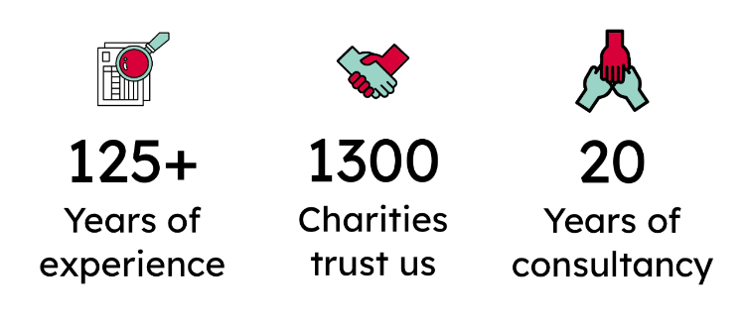
About us
The UK's leading provider of trusted legacy giving data. We now provide:
Legacy income notifications
Custom-made Analytics
Strategic Reports
Consultancy
5,000
Wills analysed
weekly

Slide 3
What can our data help with?

Slide 4
Bespoke Intelligence
Pros and Cons

Slide 5
Pros
Complete UK Coverage
Built for your strategy
Informed and Ready
Dedicated AM and Data Support

Slide 6
Cons
Lots of data
What do I do with the data?
Resource is required
Setup currently takes one to two weeks

Slide 7
Account manager for the Top 150 Charities in the UK.
Responsible for commercial activities and relations among the top 150.
Specialises in Business Intelligence and Bespoke Data.
Christopher Lincoln
Business Development Manager
Chris.Lincoln@wilmingtonplc.com

